Slide 1
What can YouTube tell us about learning to program?
https://www.youtube.com/watch?v=WvDedo8r1Fk

Slide 2
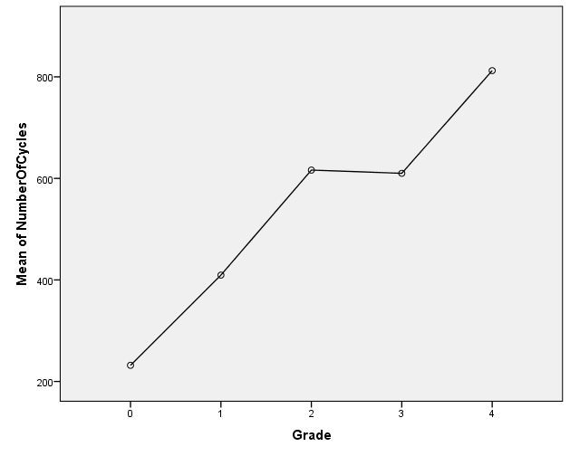
Programming is a skill that takes practice
In order to do well in this class, you will need to dedicate time outside of lecture practicing!

Slide 3
Tips for practicing
The best way to improve is to get involved in a project that you find interesting.
It’s okay if you don’t finish it or fail!
https://www.hackerrank.com has lots of practice problems ranging from basic to very complex. It’s also pretty fun!

Slide 4
On to our introduction to Algorithms…

Slide 5





Computer Languages
00101010110010
011000101110101
010111001001
10 0011
Humans
Computers
How can humans “talk to”
(instruct) computers?
Answer: Computer languages (e.g., Java, C,
Python, FORTRAN, Basic, C++, Lisp, Ruby, …)

Slide 6
Computer Languages
Natural languages are often ambiguous.
Consider: “Alice and Betty had on the same dress.”
Alice
Betty
Alice & Betty
YES
NO

Slide 7

Computer Languages
Consider: “Alice and Betty ran from the same building.”
Alice
Betty
Alice
Betty
NO
YES

Slide 8
Computer Languages
Natural languages contain a great deal of redundant
information, making them quite “fault tolerant.”
It deosn't mttaer in waht oredr the ltteers in a
word are, the iprmoatnt tihng is taht the frist
and lsat ltteer are in the rghit pcale.
Easy for a human to make sense of this despite
13 of the 27 words being misspelled.

Slide 9
Computer programs are a combination of one or more algorithms.
From Merriam-Webster:
a procedure for solving a mathematical problem (as of finding the greatest common divisor) in a finite number of steps that frequently involves repetition of an operation
Addendum from Adam:
An algorithm should always produce an expected result.
An algorithm must be in sufficient detail as to avoid ambiguity during execution.

